Slide 1

Inspections
November 18, 2002

Slide 2
Inspections
Agenda
Overview
  What is it ?
  What’s the benefit ?
  Inspections vs. Walkthroughs
Vision
Guidelines for Usage
Standard Templates
Standard Management Reporting
Standard Process
Rollout Plan

Slide 3
Inspections
Overview: What is it ?
Structured Peer Review of ADLC artifacts (Requirements, External Design, Internal Design, Test Plans..) to uncover potential defects. These peer reviews use formal meeting facilitation techniques to provide a best practice approach to identify and address critical defects that could impact downstream ADLC phases and ultimately production code.

Slide 4
Inspections
Overview: What is the benefit ?
Improved quality of production code
  Fewer production issues
  Reduced Support Costs
  Improved productivity
  Improved client satisfaction
Improved ADLC artifacts
  Better Requirements
  Better Documentation
  Better Test Planning
Reduced cycle time for ADLC phases
  Coding should require less time with better up-front analysis
  Testing should require less time with few defects
Defects can cost upwards of $1500 in production !

Slide 5
Inspections
Overview: Inspections vs. Walkthroughs
There are two types of Software Peer Reviews each serving different purposes:
  Software walkthroughs are an informal review used to confirm the understanding of the producer and validate the approach being taken.
  Software inspections are a formal review used to verify that the artifact complies with the standard of excellence. In a life cycle activity, the software inspection is the exit criteria or gate that concludes the activity.

Slide 6
Inspections
Vision 1 of 2
We will show a steady trend of improvement in the quality of inspections by measuring the “maturity” of the inspections process throughout the development teams.
We will track the penetration of inspection usage throughout the development teams.
We will provide standard metrics for measuring the overall quality of our AD deliverables providing insights on further improving our People, Process and Technologies.
We will reduce the overall costs of testing by reducing the amount of rework associated with testing defects.
We will improve the overall quality of documentation associated with the development of requirements and documentation within our AD Lifecycle.

Slide 7
Inspections
Vision 2 of 2
We will actively engage business owners and project stakeholders in the inspection process thus improving penetration beyond the development areas.
We will institute management reporting to provide ROI insights on Inspections and to track adherence to best practices.
We will establish a forum for moderators to ensure consistency is applied to inspections and to nurture ideas for continually improving the inspections process.
We will appoint an Inspector “Champion” to oversee the program. Jeff Wallk will serve as the first Champion.

Slide 8
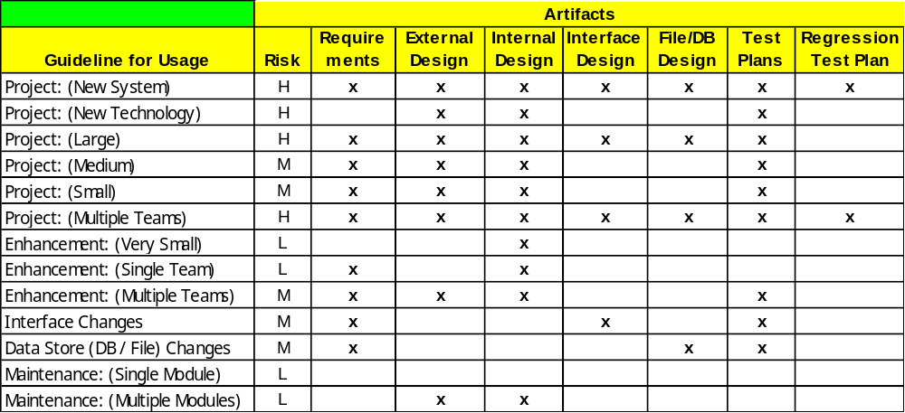
Inspections
Guidelines for Usage

Slide 9
Inspections
Standard Templates
Planning Checklist
Inspection Meeting Notice
Risk Assessment
Defect Legend
Defect Log
Defect Summary
Defect ROI
Project Summary
Exit Checklist

Slide 10
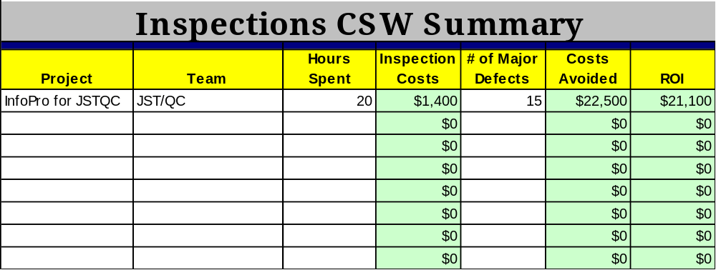
Inspections
Standard Management Reporting
CSW Summary
IBS Summary

Slide 11
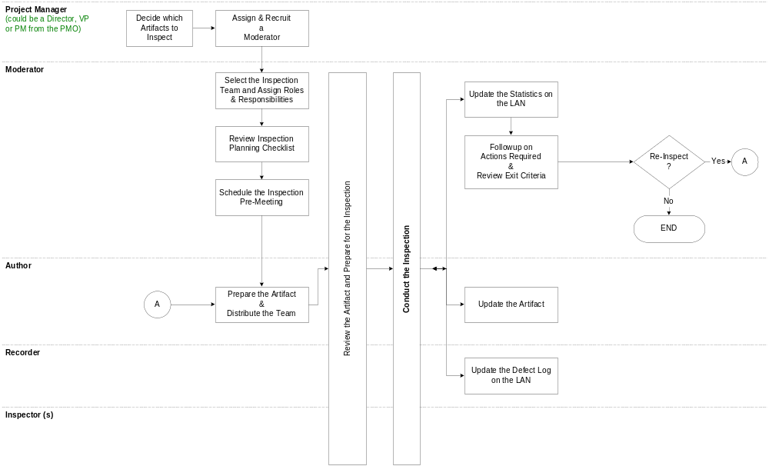
Inspections
Standard Process

Slide 12
Inspections
Rollout Plan
IBS & CSW staff are expected to begin using the process and templates going forward.
Completed Inspections templates will be kept in each project folder in the AD/CSW Doc Repositories.
A folder has been added to the AD Doc Repository to capture the IBS & CSW Summary Sheets and to hold all of the Inspections Related templates, processes and communications.
Announce Inspector “Champion” for AD areas and promote the process and provide guidance for staff.
Incorporate Inspections into Quality Plans
Incorporate Inspections into 2003 Objectives

